Slide 1
Atlas intro and setup
MongoDB Atlas
Notes:
Release: 20240216

Slide 2
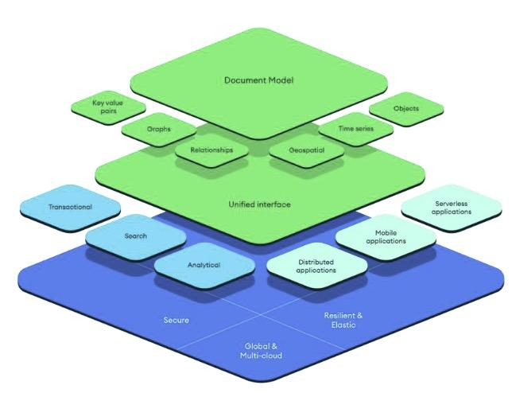

MongoDB Atlas Platform
Developer data platform that extends beyond fully managed MongoDB to help building modern applications

Slide 3
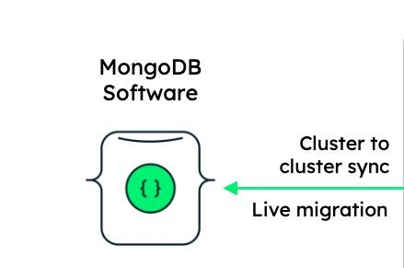
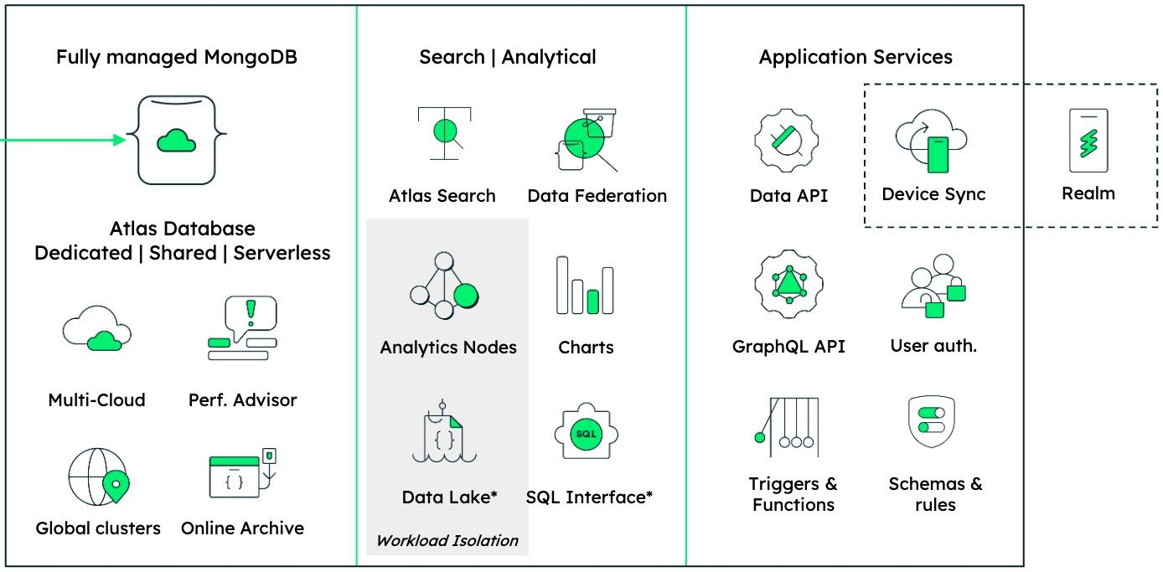
MongoDB Atlas Platform
MongoDB Self-Managed | On-Premise
Developer tooling: MongoDB Compass, VS Code Integration, MongoDB shell, idiomatic drivers in dozens of programming languages, CLI & Programmatic API for MongoDB Atlas

Slide 4
MongoDB Atlas
Fully managed database lifecycle;
Automated & elastic (auto-scale, automated data tiering, Fully managed backups with point-in-time recovery )
Data distribution with Multi-cloud ~ 110 regions (AWS, GCP, Azure)
Security controls (TLS, encrypted storage, network isolation, etc)
Intelligent recommendations (performance advisor, index recommendations, etc)
Integrated data access, movement, manipulation services for rapid application development (Data API, GraphQL API, Triggers and functions, etc)

Slide 5

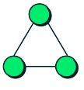



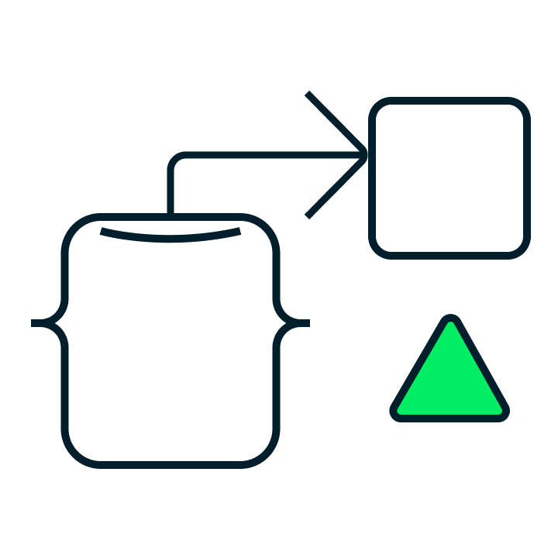

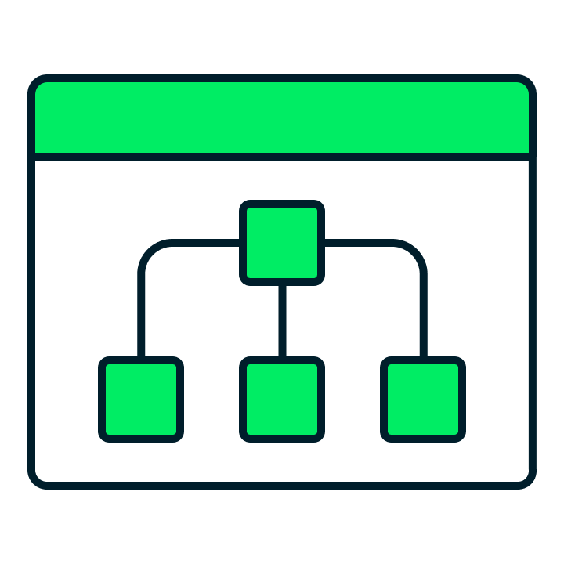



MongoDB Atlas Database
MongoDB database for modern applications:
Build-in Replication
Intuitive & Flexible Data Model
Time series collections
ACID Transactions
Change Streams
Data Distribution
Aggregation Pipelines
Schema validator
Graph Traversal
Geospatial support
Encryption & Client-side FLE | Queryable

Slide 6

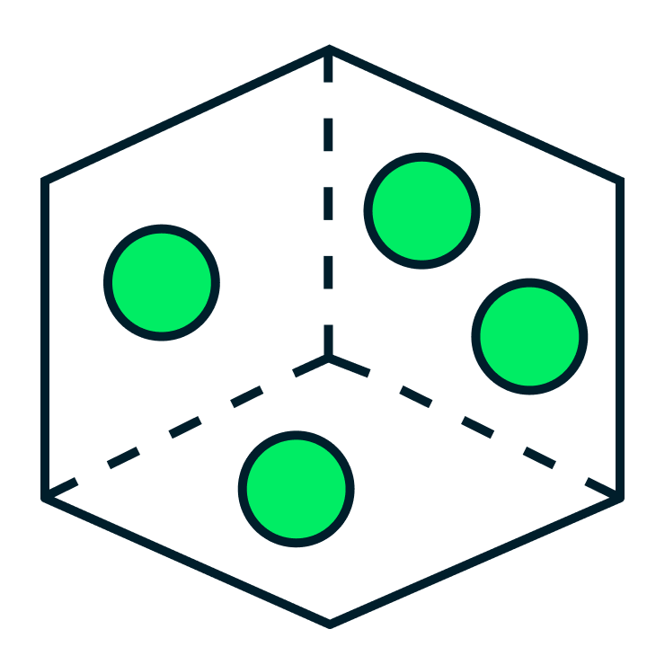
MongoDB Atlas Search & Vector Search
Integrated Search capabilities:
Atlas Search provides full-text search on top of the data in the cloud to build rich search functionality.
Atlas Vector Search provides semantic search captured in vectors to build AI-powered applications.

Slide 7

MongoDB Atlas Data Federation
Tier, query, and analyze data using MQL:
Auto-archive aged data in Atlas Data Lake
Blend, query, and analyze structured / unstructured data in a cloud object storage using MongoDB Query Language
Support for federated queries, can submit a single query and analyze operational data in Atlas alongside your data in S3

Slide 8
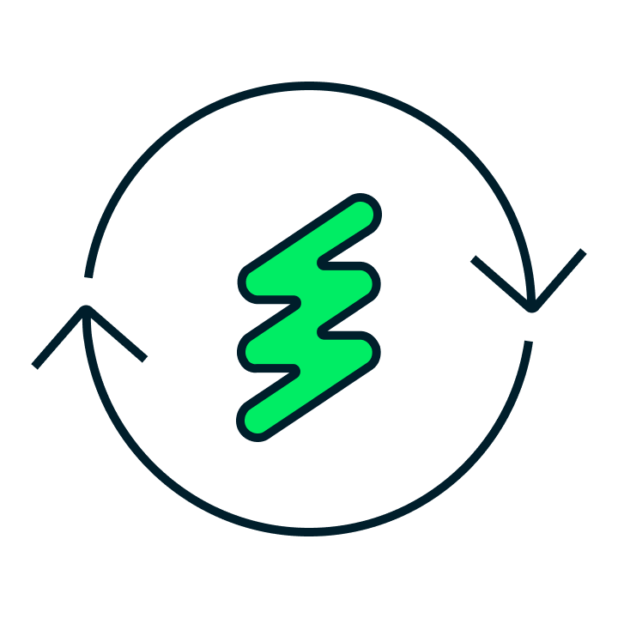
MongoDB Atlas Device Sync
Build mobile and web app faster:
Device Sync is a native integration with Atlas
Works for any mobile device or platform
Keep data between any mobile device and MongoDB Atlas in sync with with built-in conflict resolution
Resource-efficient, offline-first
Scales with your app usage

Slide 9

MongoDB Atlas Charts
Interactive data visualization:
Fastest and easiest way to create visualizations of MongoDB data
Share, embed, and collaborate on live data
Support for the document model, including nested and hierarchical data

Slide 10
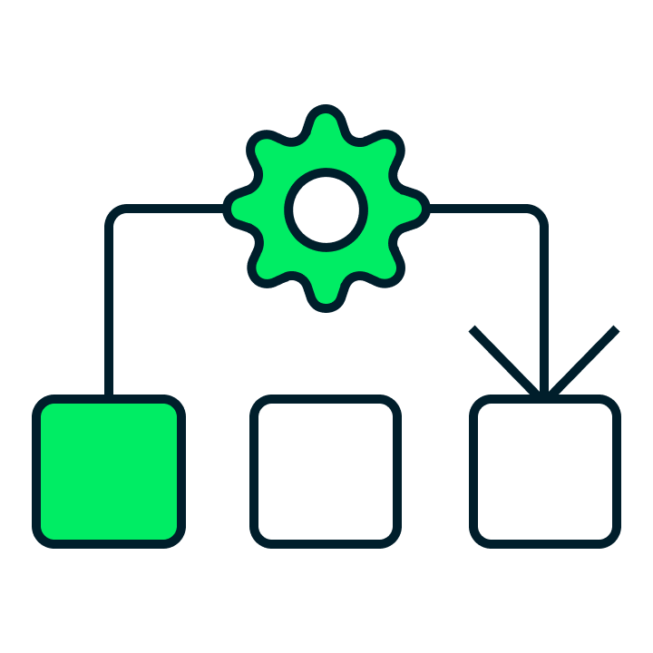

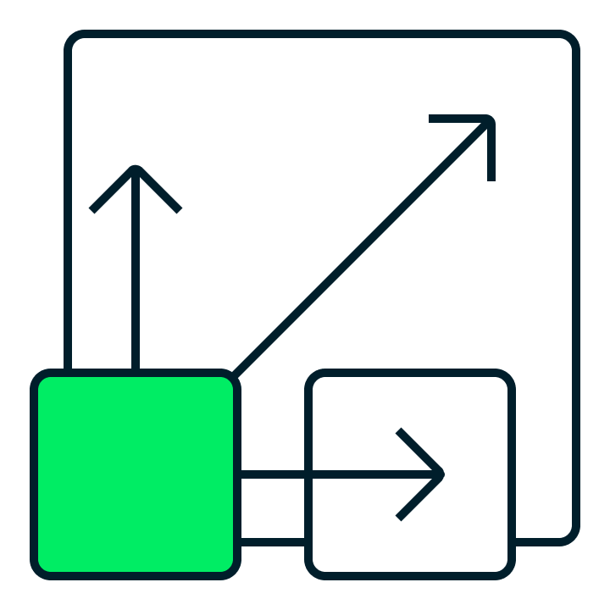
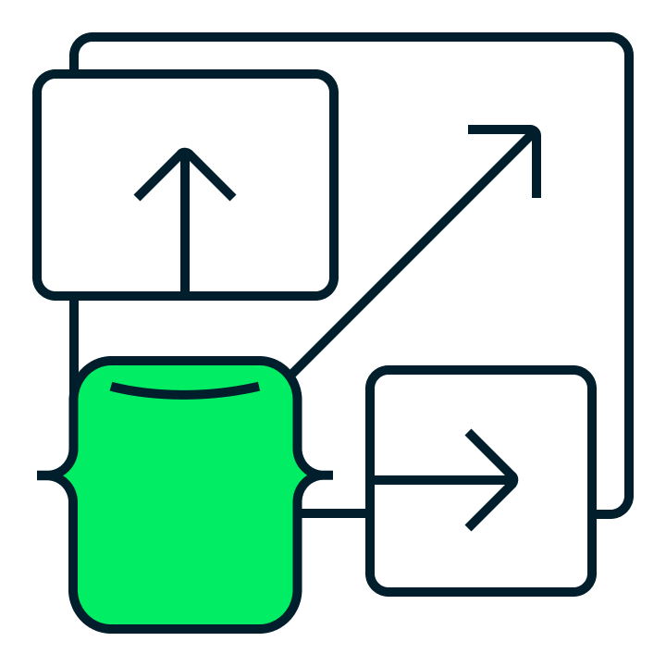







MongoDB Atlas - Multi-Cloud DBaaS
Core Database-as-a-Service features
Fully managed database lifecycle including continuous availability backed by SLA, point-in-time recovery, and more
Multi-cloud, global data distribution for low-latency data access, data sovereignty, cross-region/cloud failover, and more
Fully elastic deployments with on-demand vertical and horizontal scaling
Autopilot features, including bidirectional auto-scale, intelligent performance optimization and automatic index advice
Up-to-date security defaults, enterprise security controls, and compliance offerings (ISO 27001 · SOC 2 · PCI-DSS · HIPAA)
Powerful end user privacy protection with client-side field-level encryption
Pay-as-you-go, consumption-based pricing
Improve efficiency by auto-tiering historical data to queryable archival storage
A consistent cloud database service and experience across ~110 regions on

Slide 11
Deployment Options

Slide 12

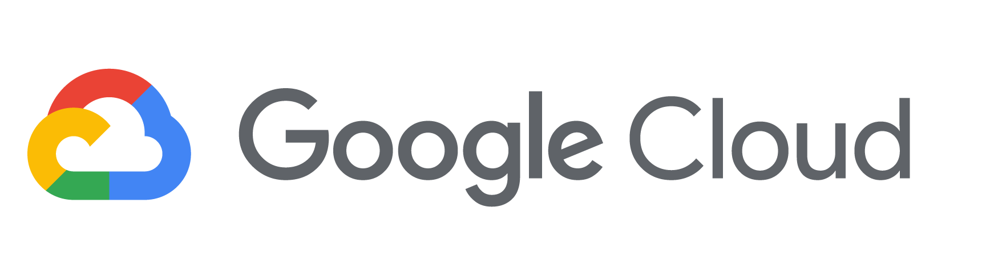

Cloud Providers
MongoDB Atlas is available on all three major clouds

Slide 13
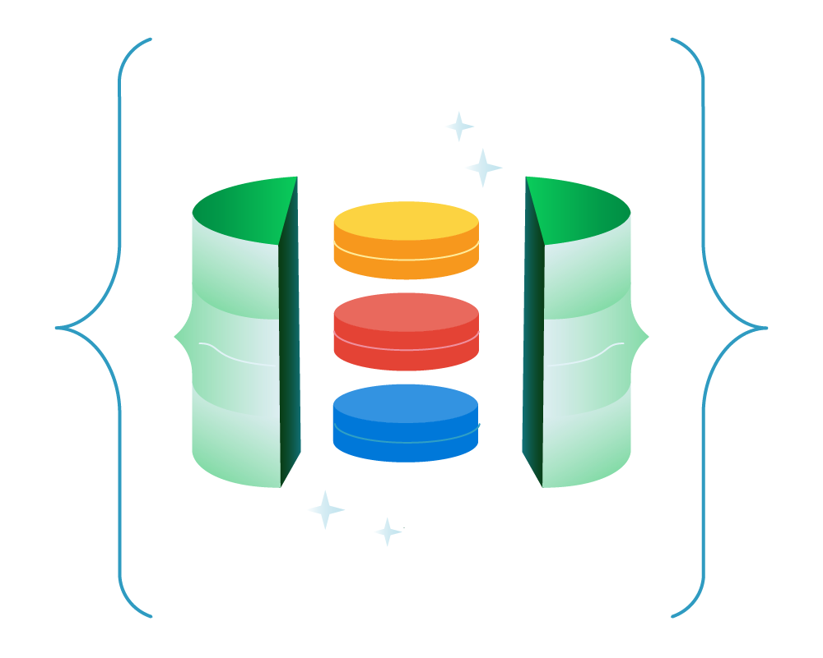
Multi-Cloud Clusters
Deploy a single cluster across multiple clouds:
Ensure High availability with cross-cloud replication
Migrate clusters from one cloud to another
Take advantage of technology across multiple clouds
Reach more users by distributing the database across more regions

Slide 14
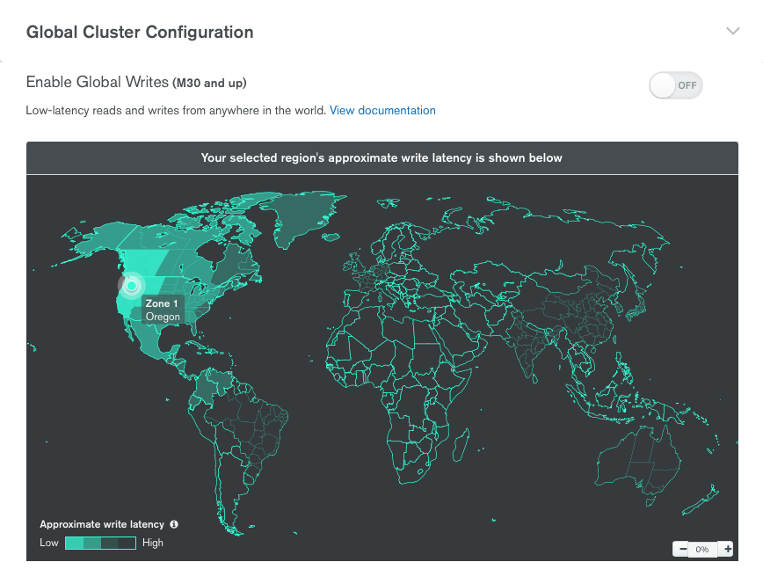
Atlas Global Clusters
MongoDB Atlas provides a highly curated implementation of zoned sharding to support location-aware reads and writes for globally distributed applications

Slide 15
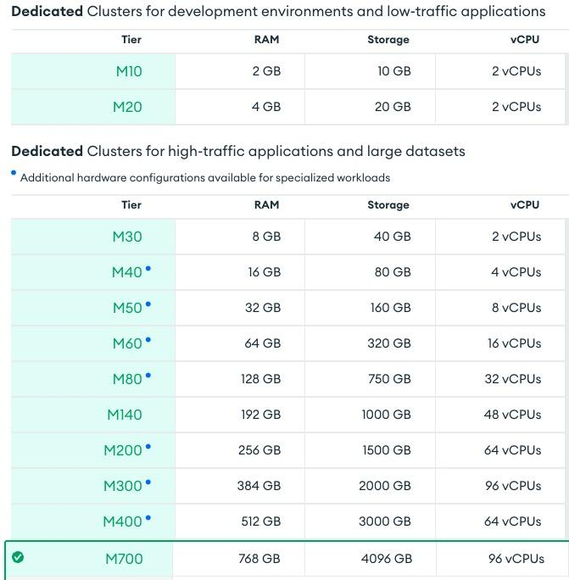
Cluster Tier
Choose your cluster tier
Shared
Dedicated, low-traffic
Dedicated, high-traffic
Severless
Fine-tune with tier options
Class
Storage
Auto-scale
IOPS
Network resources determined by the tier

Slide 16
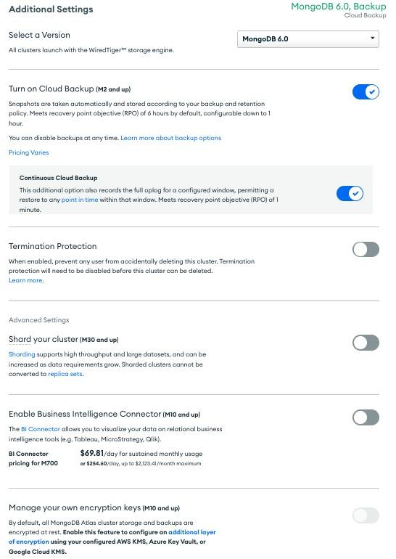
Additional Settings
MongoDB version
Backup
Sharding
BI Connector
Encryption key management
And more…

